Slide 1
Internet Protocols
#Lecture05

Slide 2
Background
Internet protocols were first developed in the mid-1970s
Defense Advanced Research Projects Agency (DARPA) became interested in establishing a packet-switched network that would facilitate communication between dissimilar computer systems at research institutions.
TCP/IP later was included with Berkeley Software Distribution (BSD) UNIX and has since become the foundation on which the Internet and the World Wide Web (WWW) are based.

Slide 3
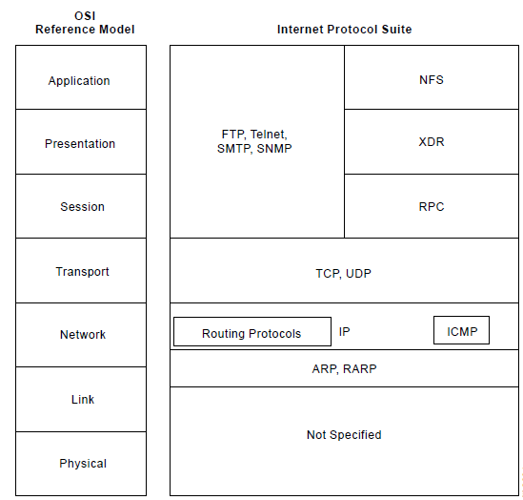
Internet Protocol Suite

Slide 4
IP….
The Internet Protocol (IP) is a network-layer (Layer 3) protocol
contains addressing information and some control information that enables packets to be routed.
IP is documented in RFC 791
IP has two primary responsibilities:
-providing connectionless, best-effort delivery of datagrams through an internetwork;
- providing fragmentation and reassembly of datagrams to support data links with different maximum transmission unit (MTU) sizes.

Slide 5
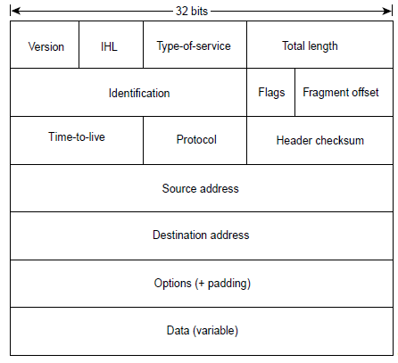
IP packet

Slide 6
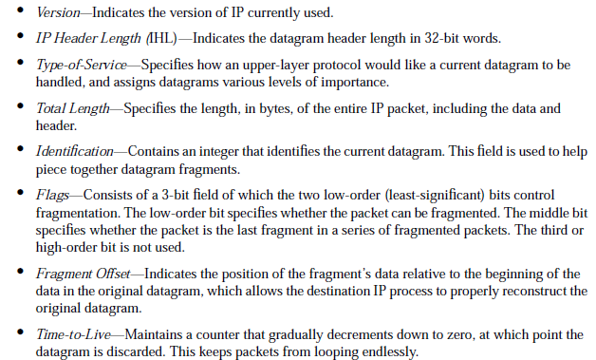
IP packet…..

Slide 7
IP packet…..
Header Checksum—Helps ensure IP header integrity.
Source Address—Specifies the sending node.
Destination Address—Specifies the receiving node.
Options—Allows IP to support various options, such as security.
Data—Contains upper-layer information.

Slide 8
IP Addressing
IP Address Format
IP Address Classes

Slide 9
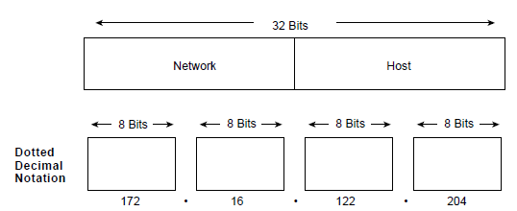

Slide 10
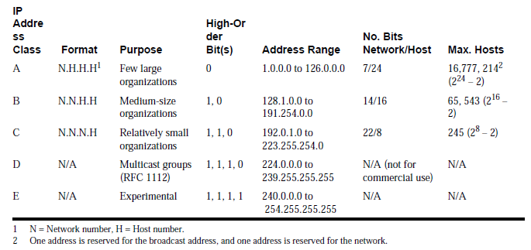

Slide 11
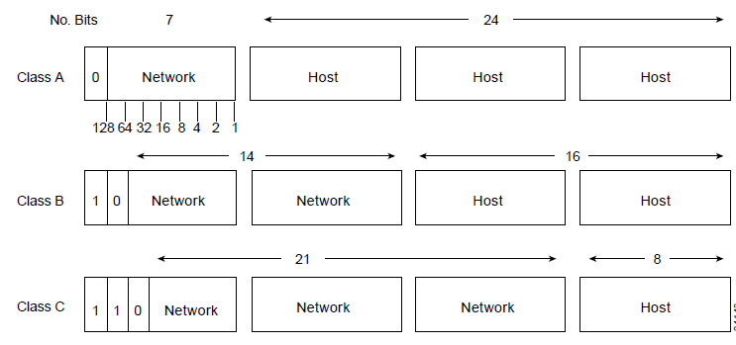

Slide 12
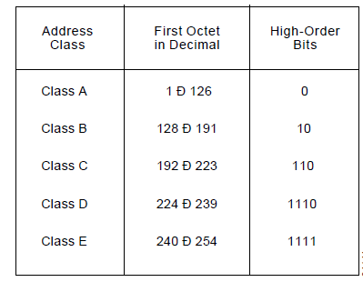

Slide 13
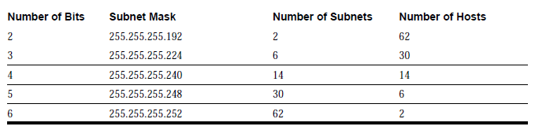
IP Subnet Addressing
IP Subnet Mask

Slide 14
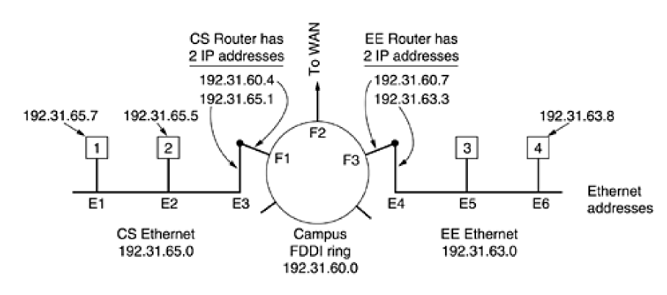
Address Resolution Protocol (ARP)
a host can dynamically discover the MAC-layer address corresponding to a particular IP network-layer address.

Slide 15
IP software on host 1 builds an Ethernet frame addressed to E2
puts the IP packet (addressed to 192.31.65.5) in the payload field, and dumps it onto the Ethernet.
The Ethernet board of host 2 detects this frame, recognizes it as a frame for itself, scoops it up, and causes an interrupt.
The Ethernet driver extracts the IP packet from the payload and passes it to the IP software, which sees that it is correctly addressed and processes it.
Reverse Address Resolution Protocol (RARP) is used to map MAC-layer addresses to IP addresses.

Slide 16
Internet Routing
Interior Gateway Protocols (IGPs): ex- RIP
exterior gateway protocol: ex-OSPF

Slide 17
RIP
RIP Characteristics
A classful, Distance Vector (DV) routing protocol
Metric = hop count
Routes with a hop count > 15 are unreachable
Updates are broadcast every 30 seconds
Bellman-Ford routing algorithm and the Ford-Fulkerson algorithm

Slide 18
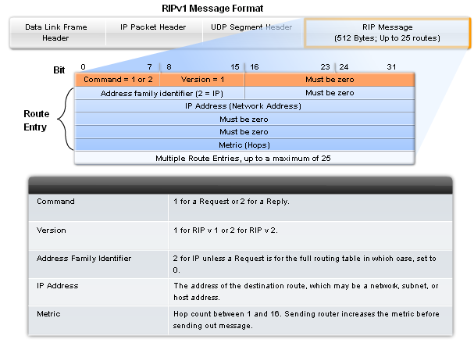

Slide 19
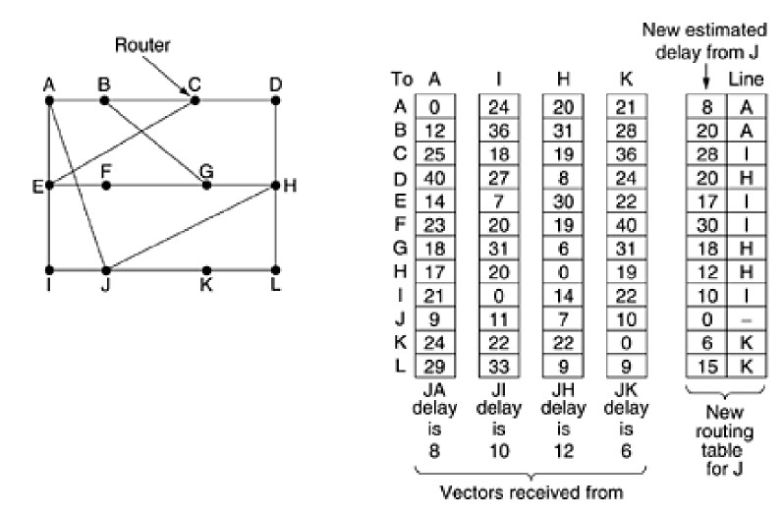
Distance Vector Routing

Slide 20
Link-State Routing
Dikjstra’s algorithm also known as the shortest path first (SPF) algorithm
Assignment:
Code the algorithm in C/JAVA/C++/C#

Slide 21
Internet Control Message Protocol (ICMP)
a network-layer Internet protocol that provides message packets to report errors and other information regarding IP packet processing back to the source. ICMP is documented in RFC 792.
ICMPs generate several kinds of useful messages:
Destination Unreachable,
Echo Request and Reply,
Redirect,
Time Exceeded, and
Router Advertisement and Router Solicitation.

Slide 22
ICMP….
Destination-unreachable messages include four basic types: network unreachable, host unreachable, protocol unreachable, and port unreachable.
Network-unreachable messages usually mean that a failure has occurred in the routing or addressing of a packet.
Host-unreachable messages usually indicates delivery failure, such as a wrong subnet mask.
Protocol-unreachable messages generally mean that the destination does not support the upper-layer protocol specified in the packet.
Port-unreachable messages imply that the TCP socket or port is not available.

Slide 23
ICMP Router-Discovery Protocol (IDRP)
IDRP uses Router-Advertisement and Router-Solicitation messages to discover the addresses of routers on directly attached subnets.
Each router periodically multicasts Router-Advertisement messages from each of its interfaces.
Hosts then discover addresses of routers on directly attached subnets by listening for these messages.
Hosts can use Router-Solicitation messages to request immediate advertisements rather than waiting for unsolicited messages.

